Slide 1
ACP - GCD and prime number

Slide 2
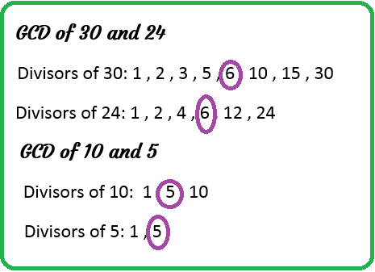
The Greatest Common Divisor
GCD (Greatest Common Divisor) or HCF (Highest Common Factor) of two numbers is the largest number that divides both of them.

Slide 4
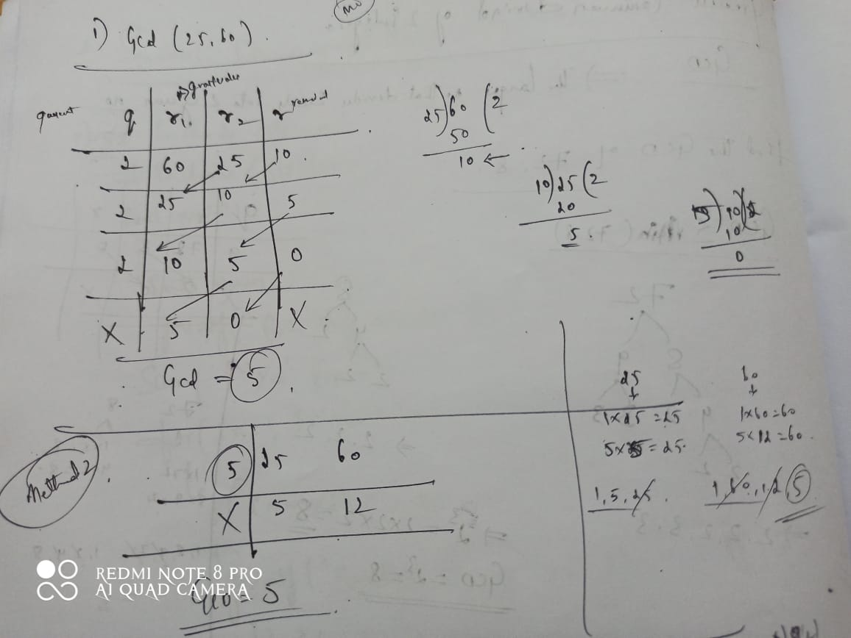

Slide 5

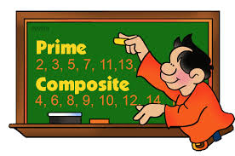
Generating prime numbers
Prime number is a number that is greater than 1 and divided by 1 or itself.
In other words, prime numbers can't be divided by other numbers than itself or 1.

Slide 6
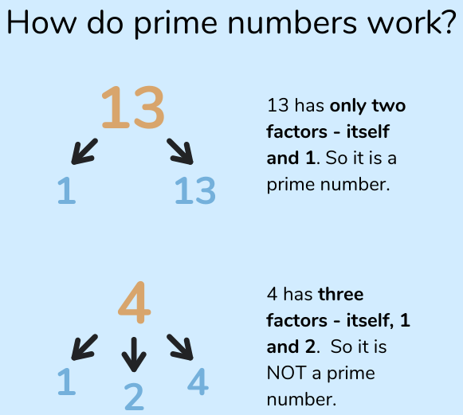

Slide 8
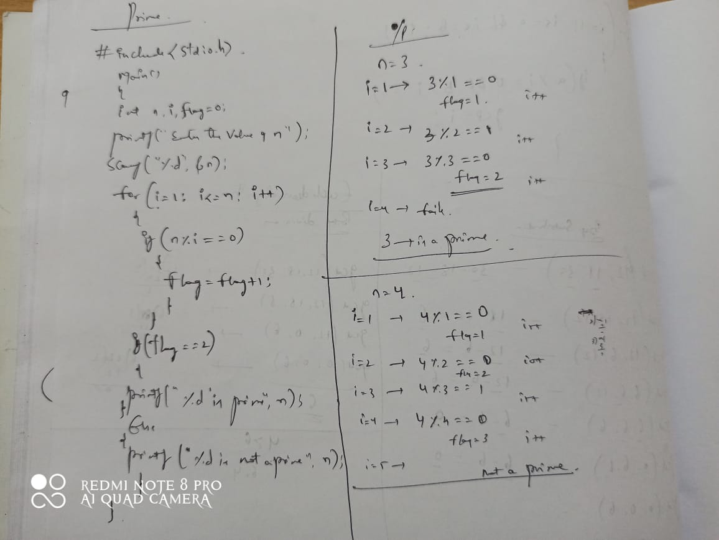
Program to find prime number

Slide 9
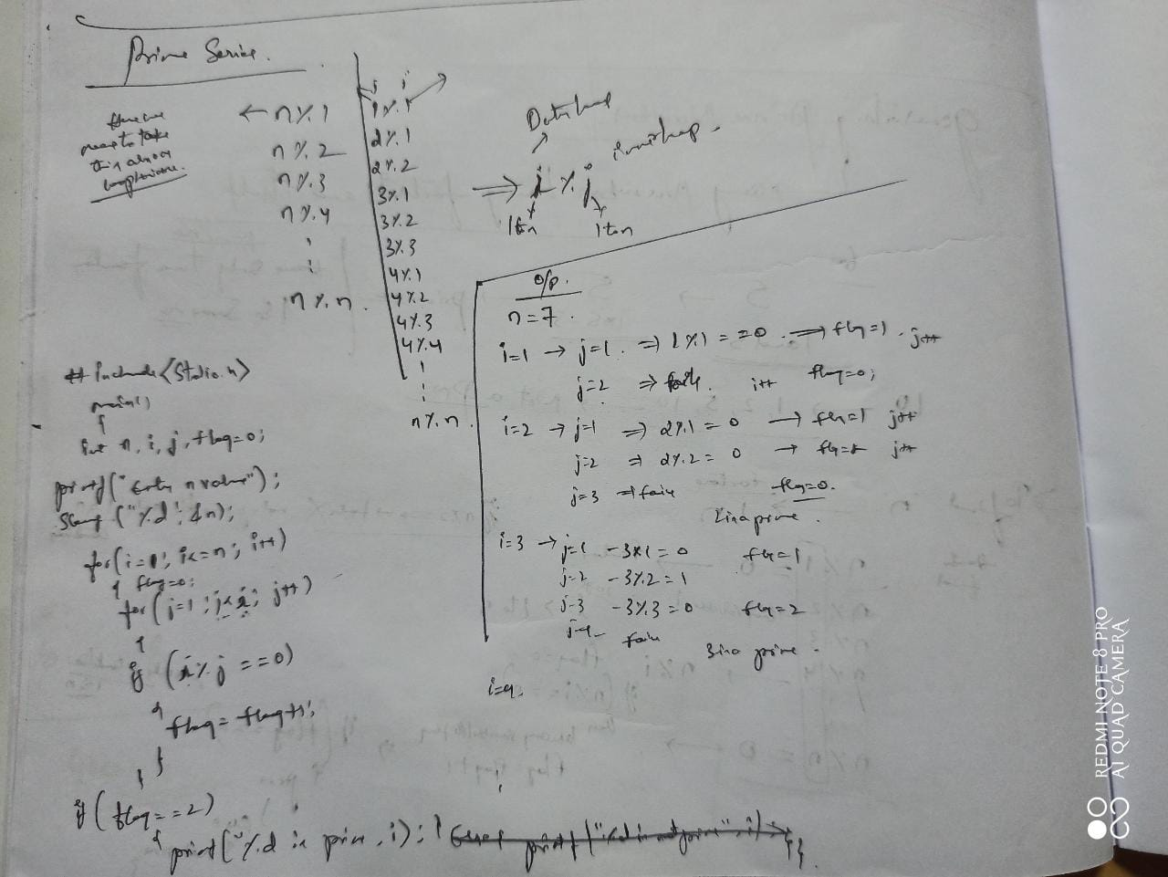
Program – Prime series

